Slide 1
State Space Models and Filtering
Daniel C

Slide 2
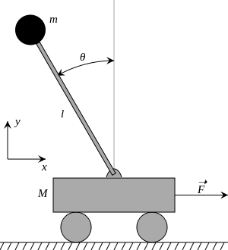
Inverted Pendulum

Slide 3
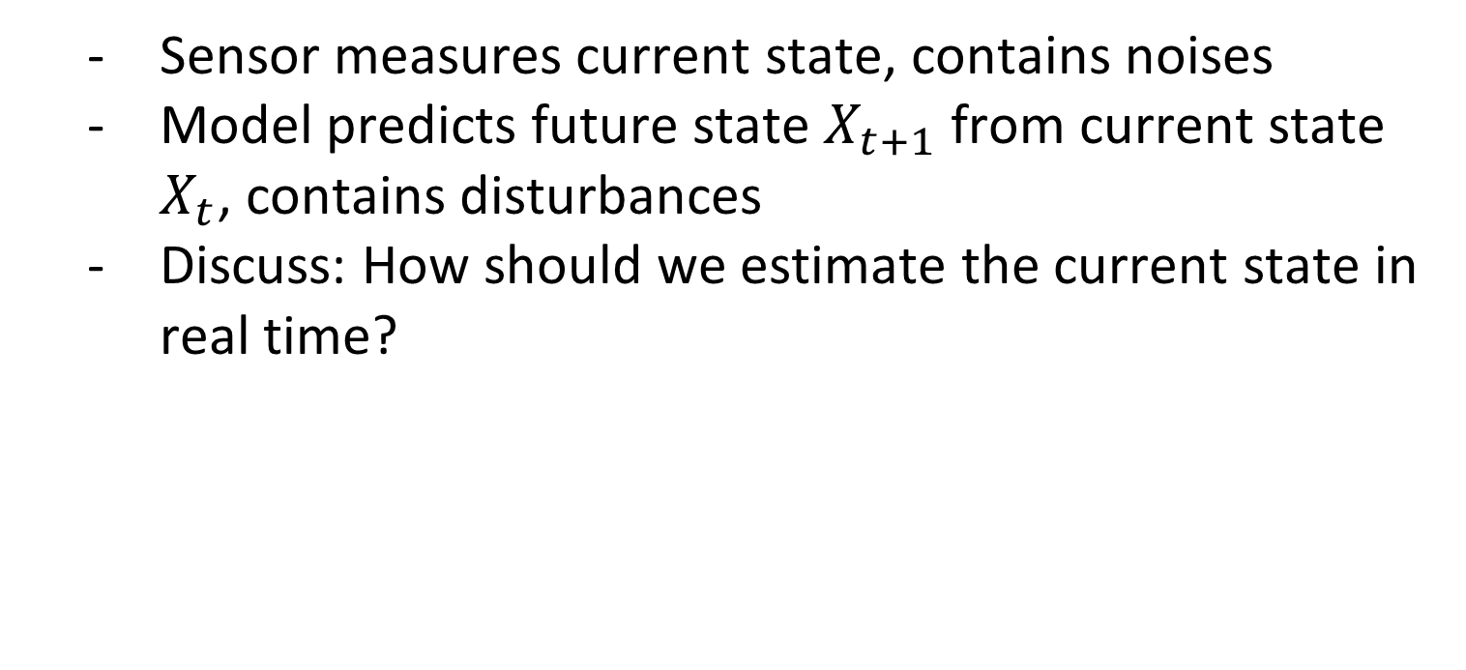
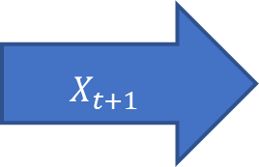
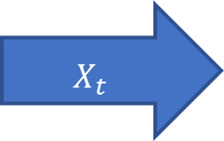
State space models
Sensor measures current state, contains noises
Model predicts future state $X_{t+1}$ from current state $X_{t}$, contains disturbances
Discuss: How should we estimate the current state in real time?
Model
Sensor
$$X_{t}$$
$$X_{t+1}$$

Slide 4
State space models
Filtering:
Estimating the current state based on all information available
Balance different sources of uncertainties
Trust measurements more if noises are smaller than model disturbances
Trust model predictions more if disturbances are smaller than noises

Slide 5
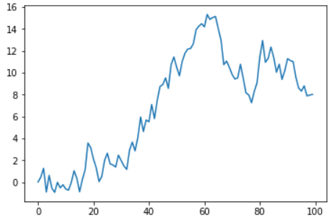
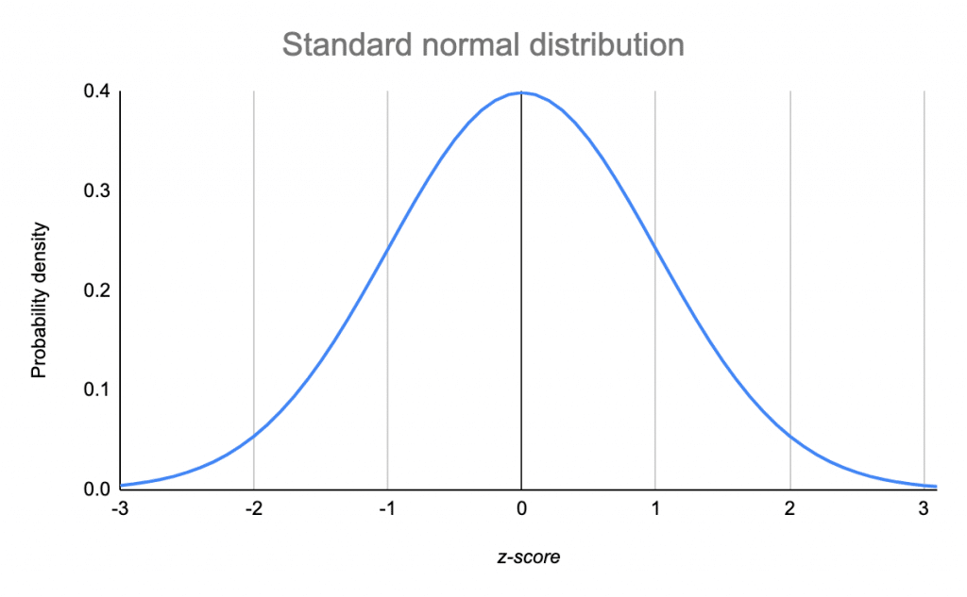
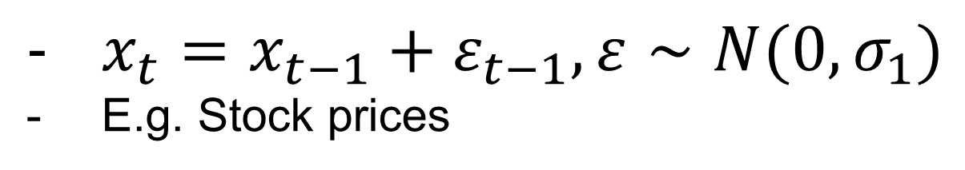
Example: Random walk
$x_{t}=x_{t−1}+ε_{t−1},ε∼N(0,σ_{1})$
E.g. Stock prices

Slide 6
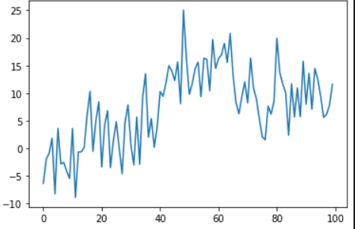
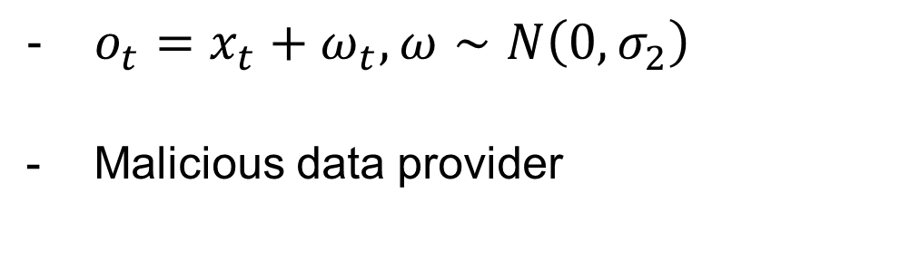
Example: Random walk
$o_{t}=x_{t}+ω_{t},ω∼N\left(0,σ_{2}\right)$
Malicious data provider

Slide 7
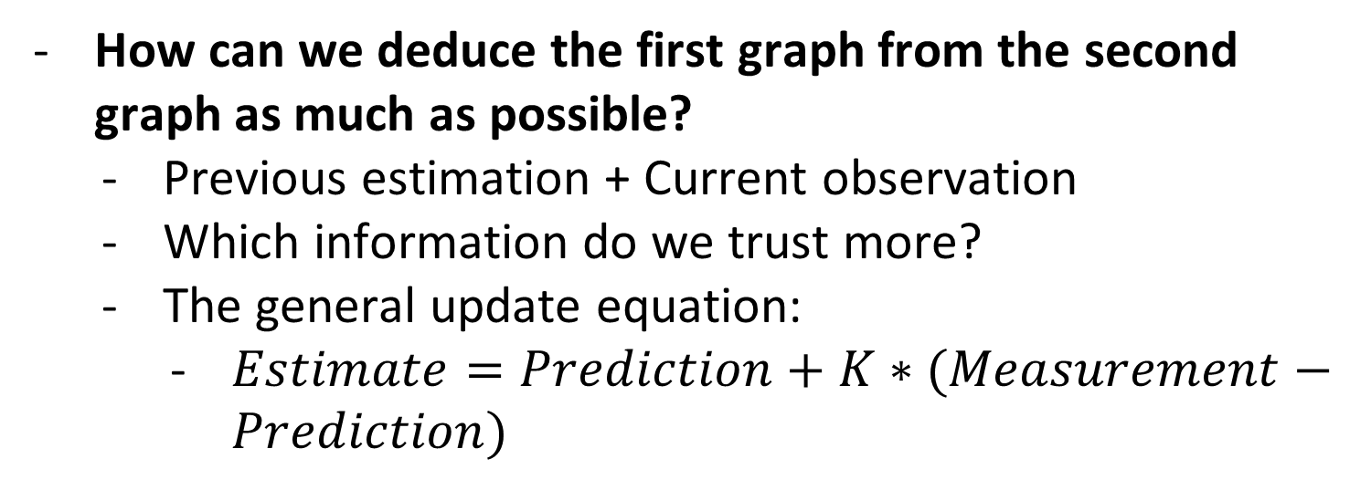
Example: Random walk
How can we deduce the first graph from the second graph as much as possible?
Previous estimation + Current observation
Which information do we trust more?
The general update equation:
$Estimate=Prediction+K∗(Measurement−Prediction)$

Slide 8

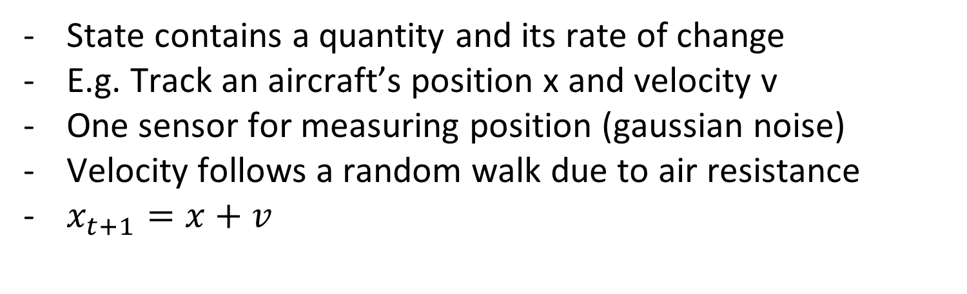
Alpha beta filter
State contains a quantity and its rate of change
E.g. Track an aircraft’s position x and velocity v
One sensor for measuring position (gaussian noise)
Velocity follows a random walk due to air resistance
$x_{t+1}=x+v$

Slide 9
Alpha beta filter
Alpha: Relative trust in measurement vs prediction of position
Beta: Relative trust in measurement vs prediction of velocity
If measured position is greater than prediction, then:
Previous estimated position is too low
Previous estimated velocity is too low
Some combination of both
Measurement greater than actual position

Slide 10
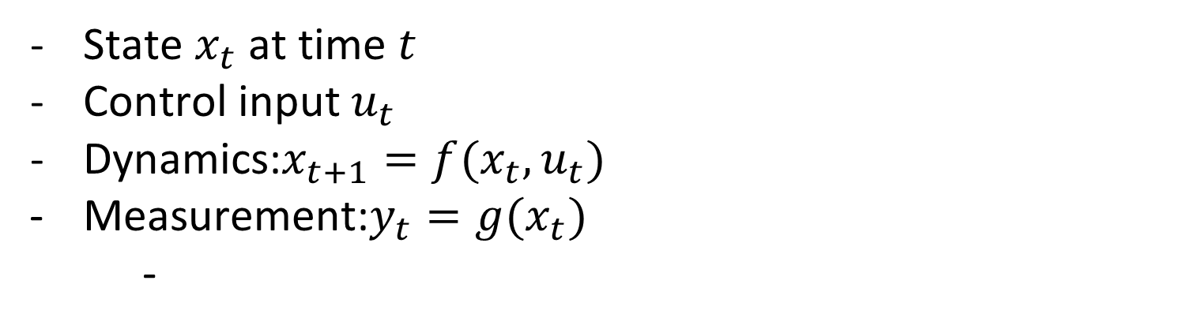
Control
State $x_{t}$ at time $t$
Control input $u_{t}$
Dynamics:$x_{t+1}=f(x_{t},u_{t})$
Measurement:$y_{t}=g(x_{t})$
-

Slide 11
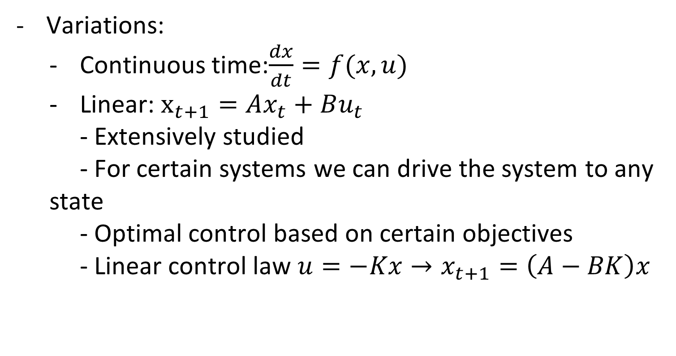
Control
Variations:
Continuous time:$\frac{dx}{dt}=f(x,u)$
Linear: $x_{t+1}=Ax_{t}+Bu_{t}$
- Extensively studied
- For certain systems we can drive the system to any state
- Optimal control based on certain objectives
- Linear control law $u=−Kx→x_{t+1}=\left(A−BK\right)x$

Slide 12
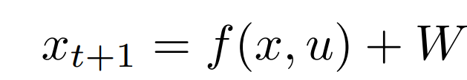
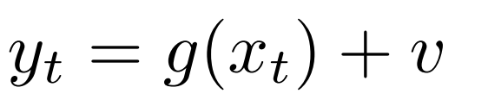
Control with uncertainty
State transition:
Measurement:

Slide 13

Filters for control
From noisy measurement
To estimation of full state:

Slide 14

Closing the loop
The control law:

Slide 15


Objectives
Target state deviation(e.g. thermostat):
Integral cost(e.g. fuel consumption):

Slide 16
Inverted Pendulum
States:
Position
Velocity
Angle
Angular velocity

Slide 17
Inverted Pendulum
Disturbances:
Position
Velocity
Normally distributed with variance 0.01
Measurement:
noises on all variables
Normally distributed with variance 0.1

Slide 18
Inverted Pendulum
Disturbances:
Position
Velocity
Normally distributed with variance 0.01
Measurement:
noises on all variables
Normally distributed with variance 0.1

Slide 19
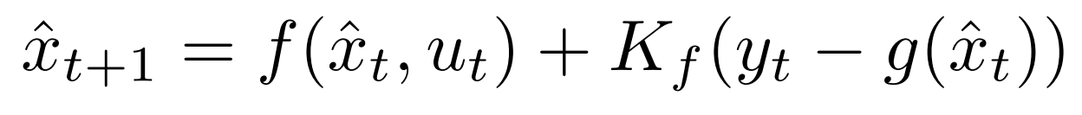
The kalman filter
Computes a matrix Kf based on dynamics
Predict and update the estimate:
Such that expectation of error is minimized

Slide 20

The controller
Linear Quadratic Regulator: Computes a matrix K based on cost and dynamics
The control law is
Minimizes the objective

Slide 21
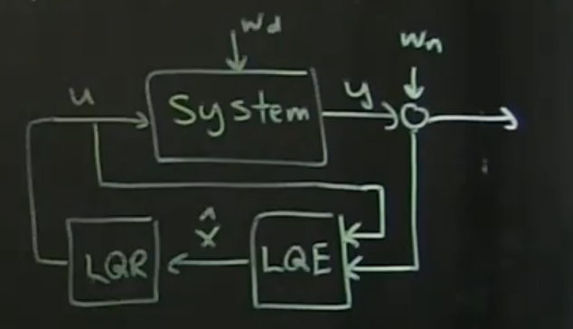
Full picture
Closed loop control with filtering

